Slide 1
Cancer Cases
Presented By:
Danielle Dillon
Jaelin Singletary
Monserrat Miranda
Sky Ramos

Slide 2

Highest Documented Cancer Type for Women
Factors that Induce Breast Cancer In Women
Eating Habits
Weight Issues
268.66k

Slide 3

Lowest Documented Cancer Type in Women
Reasons Why ....
Not common in women
Inherited syndromes
1,470

Slide 4
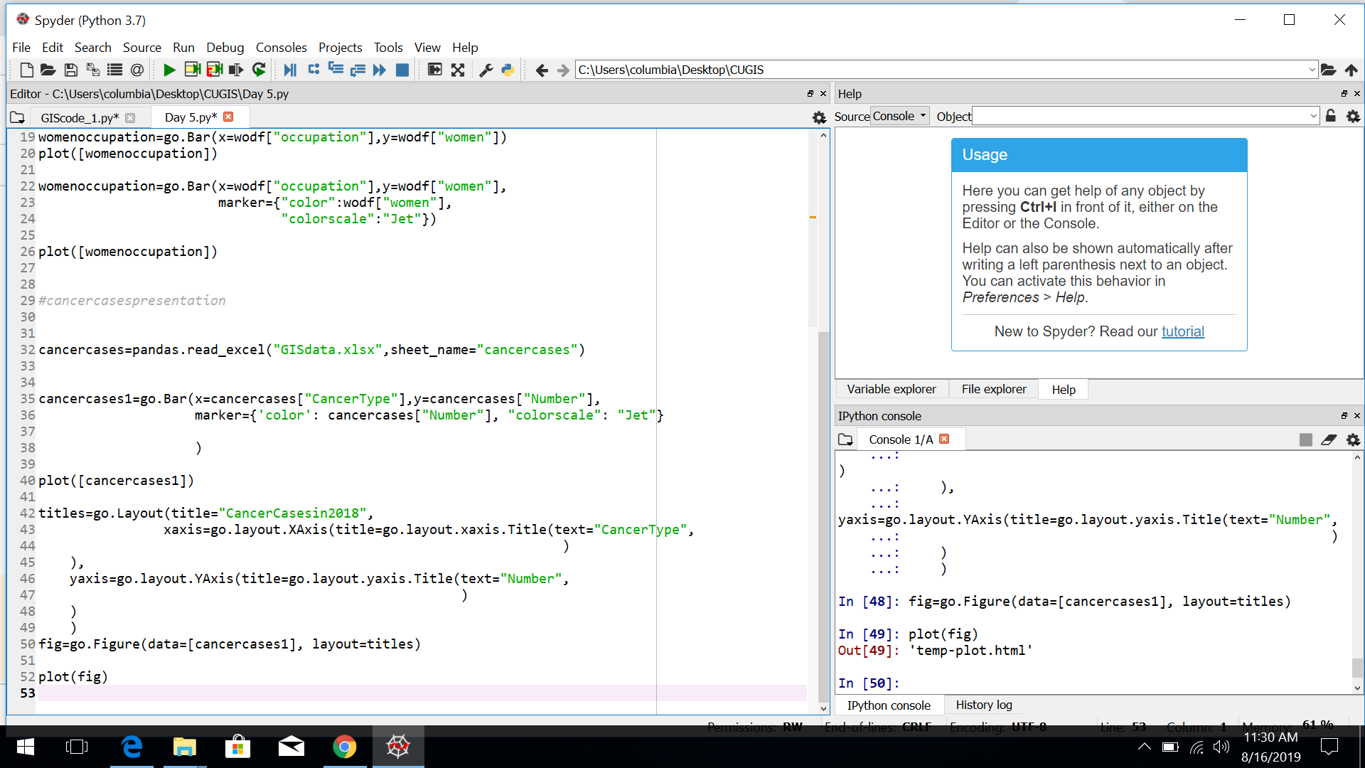
Behind The Scenes

Slide 5
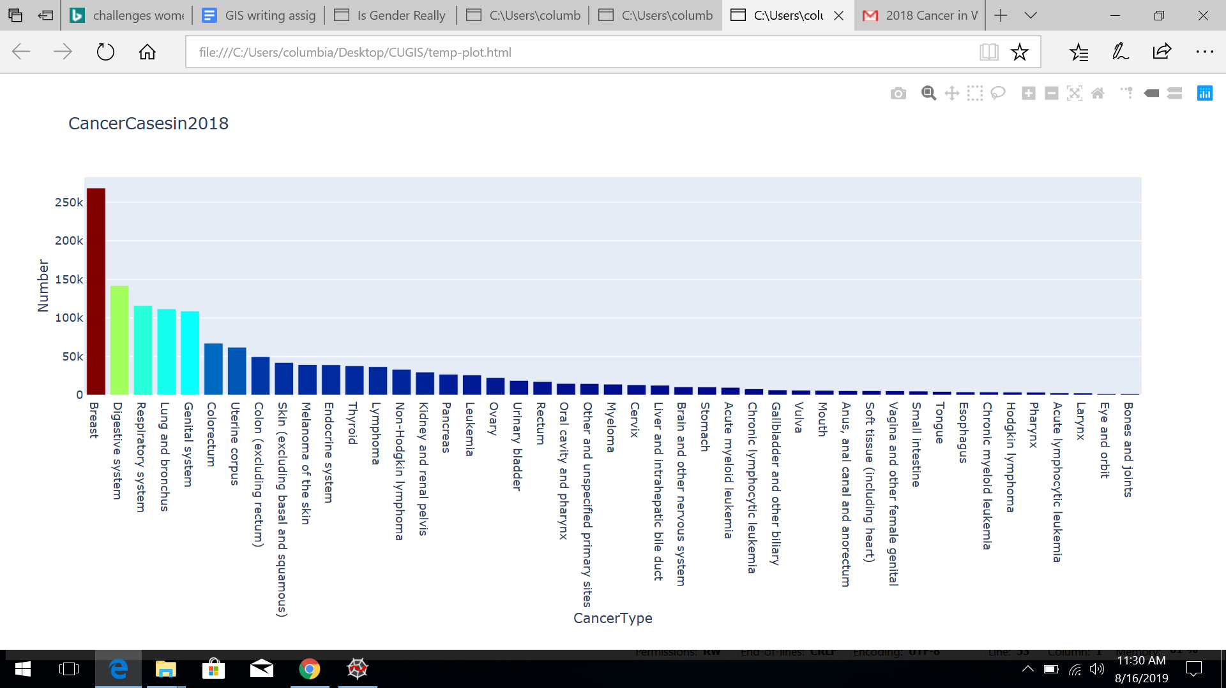

Slide 6
Conclusion
We believe we should do more research on breast cancer and figure out why it’s variating more in women than men and why such a big amount has it.

Slide 7
Thank you, for listening to our presentation.

